Slide 1

How do Organisms
Reproduce?
Female Reproductive System
Implantation

Slide 2
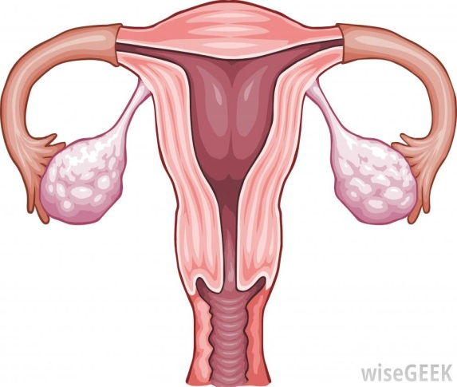
Female Reproductive System
The female germ-cells or eggs are made in the ovaries.
They are also responsible for the production of some hormones.
When a girl is born, the ovaries already contain thousands of immature eggs.
Ovary

Slide 3


Female Reproductive System
On reaching puberty, some of these start maturing.
One egg is produced every month by one of the ovaries.
Ovary

Slide 4
Female Reproductive System
The egg is carried from the ovary to the womb through a thin oviduct or fallopian tube.
Uterus
Oviduct or Fallopian tube
Ovary

Slide 5
Female Reproductive System
The two oviducts unite into an elastic bag-like structure known as the uterus.
Oviduct or Fallopian tube
Ovary
Uterus

Slide 6
Female Reproductive System
The uterus opens into the vagina through the cervix.
Oviduct or Fallopian tube
Ovary
Uterus
Cervix
Vagina

Slide 7
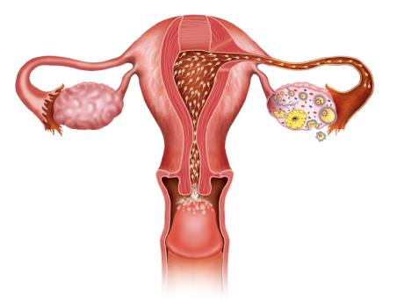
Female Reproductive System
The sperms enter through the vaginal passage during sexual intercourse.
The act of reproduction

Slide 8
Female Reproductive System
They travel upwards and reach the oviduct where they may encounter the egg.

Slide 9
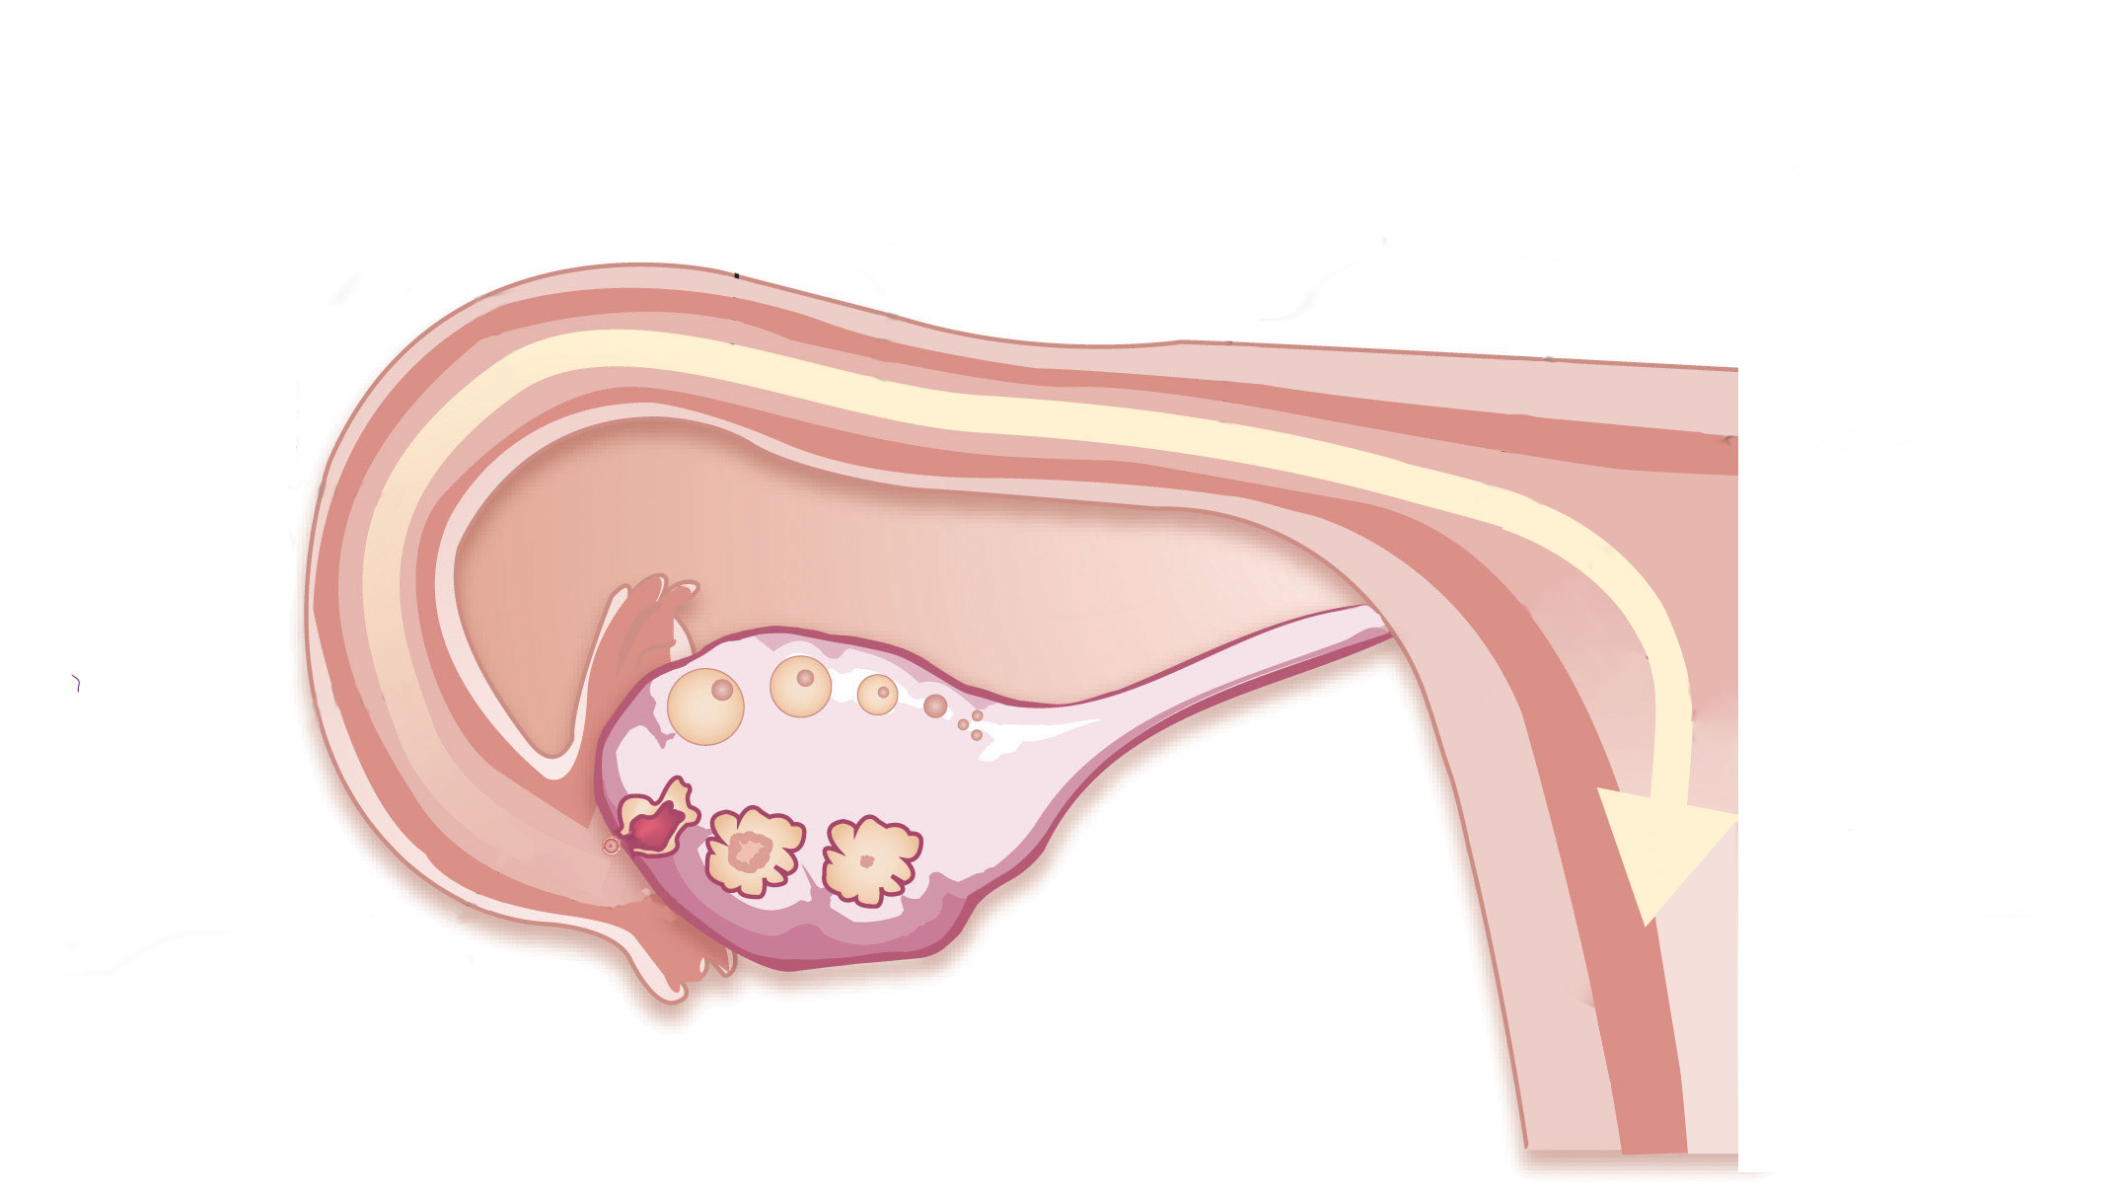







Female Reproductive System
The fertilised egg, the zygote, gets implanted in the lining of the uterus, and starts dividing.
The attachment of the fertilized egg or zygote to the wall of the womb at the start of pregnancy.
Implanted

Slide 10
Female Reproductive System
The fertilised egg, the zygote, gets implanted in the lining of the uterus, and starts dividing.
For differentiation into various tissues
Implanted

Slide 11
Thank You

